Slide 1
Functional Dependencies and Normalization for Relational Databases
PART 2

Slide 2
Normalization
Normalization is the process of efficiently organizing data in a database with two goals in mind
First goal: eliminate redundant data
for example, storing the same data in more than one table
Second Goal: ensure data dependencies make sense
for example, only storing related data in a table

Slide 3
Benefits of Normalization
Less storage space
Quicker updates
Less data inconsistency
Clearer data relationships
Easier to add data
Flexible Structure

Slide 4
The Solution: Normal Forms
Bad database designs results in:
redundancy: inefficient storage.
anomalies: data inconsistency, difficulties in maintenance
1NF, 2NF, 3NF, BCNF are some of the early forms in the list that address this problem

Slide 5
Brief History/Overview
Database Normalization was first proposed by Edgar F. Codd.
Codd defined the first three Normal Forms.
One of the key requirements to remember is that Normal Forms are progressive. That is, in order to have 3rd NF we must have 2nd NF and in order to have 2nd NF we must have 1st NF.

Slide 6
1st Normal Form The Requirements
The requirements to satisfy the 1st NF:
The values in each column of a table are atomic (No multi-value attributes allowed).
There are no repeating groups: two columns do not store similar information in the same table.

Slide 7
1) First normal form -1NF
1NF : if all attribute values are atomic: no repeating group, no multivalued attributes.
The following table is not in 1NF
DPT_NO | MG_NO | EMP_NO | EMP_NM
D101 | 12345 | 20000 20001 20002 | Carl Sagan Mag James Larry Bird
D102 | 13456 | 30000 30001 | Jim Carter Paul Simon

Slide 8
Table in 1NF
DPT_NO | MG_NO | EMP_NO | EMP_NM
D101 | 12345 | 20000 | Carl Sagan
D101 | 12345 | 20001 | Mag James
D101 | 12345 | 20002 | Larry Bird
D102 | 13456 | 30000 | Jim Carter
D102 | 13456 | 30001 | Paul Simon
all attribute values are atomic because there are no repeating group and no composite attributes.

Slide 9
Second Normal Form
Uses the concepts of FDs, primary key
Definitions
Prime attribute: An attribute that is member of the primary key K.
Non Prime attribute: An attribute that is not a member of the primary key K.
Full functional dependency: a FD Y -> Z where removal of any attribute from Y means the FD does not hold any more

Slide 10
Second Normal Form
Examples:
{SSN, PNUMBER} -> HOURS is a full FD since neither SSN -> HOURS nor PNUMBER -> HOURS hold
{SSN, PNUMBER} -> ENAME is not a full FD (it is called a partial dependency ) since SSN -> ENAME also holds

Slide 11
Partial FDs and 2NF
Partial FDs:
A FD, A → B is a partial FD, if some attribute of A can be removed and the FD still holds
Formally, there is some proper subset of A,
C ⊂ A, such that C → B
Let us call attributes which are part of some candidate key, key attributes, and the rest non-key attributes.
Second normal form:
A relation is in second normal form (2NF) if it is in 1NF and no non-key attribute is partially dependent on a candidate key.
In other words, no C → B where C is a strict subset of a candidate key and B is a non-key attribute.

Slide 12
Second Normal Form (2)
A relation schema R is in second normal form (2NF) if it is in 1NF and every non-prime attribute A in R is fully functionally dependent on the primary key.
A relation in 2NF will not have any partial dependencies.
R can be decomposed into 2NF relations via the process of 2NF normalization

Slide 13
Second Normal Form
Consider this Order table (in 1NF):
Order no
item code
Order date
Qty
Price_ per_unit
orderno, itemcode
Order_date
orderno, itemcode
Qty
orderno, itemcode
Price_per_unit
Item code
Price_per_unit
Order no
Order date
Order is not 2NF since there is a partial dependency of
Item code on Price_per_unit.

Slide 14
Second Normal Form
Consider this Order table (in 1NF):
Order no
item code
Order date
Qty
Price_ per_unit
We can improve the database by decomposing the relation into three relations:
Order no
Order date
item code
Price_ per_unit
Order no
item code
Qty

Slide 15
Third Normal Form
Third Normal Form
A relation in 3NF will not have any transitive dependencies
of non-key attribute on a candidate key through another non-key attribute.

Slide 16
Third Normal Form
Let R be a relation schema, F be the set of FDs given to hold over R, X be a subset of the attributes of R, and A be an attribute of R. R is in third normal form if, for every FD….
A relation is in third normal form if it holds atleast one of the following conditions for every non-trivial function dependency X → Y.
X is a super key.
Y is a prime attribute, i.e., each element of Y is part of some candidate key.

Slide 17
Third Normal Form
Consider this Employee relation
EmpNum
EmpName
DeptNum
DeptName
EmpName, DeptNum, and DeptName are non-key attributes.
DeptNum determines DeptName, a non-key attribute.
Is the relation in 3NF? … no
Is the relation in 2NF? … yes

Slide 18
Third Normal Form
EmpNum
EmpName
DeptNum
DeptName
We correct the situation by decomposing the original relation into two 3NF relations. Note the decomposition is lossless.
EmpNum
EmpName
DeptNum
DeptNum
DeptName
Verify these two relations are in 3NF.

Slide 19
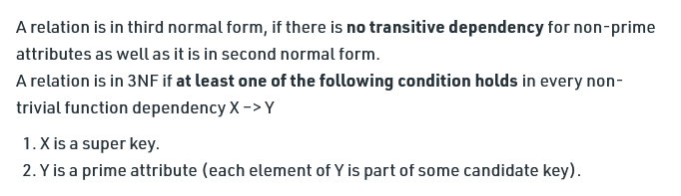

Slide 20
Boyce Codd Normal Form
A relation R is in BCNF if R is in Third Normal Form
Let R be a relation schema, F be the set of FD’s given to hold over R, .X be a subset of the attributes of R, and A be an attribute of R. R is in Boyce-Codd normal form if, for every FD X → A in F, one of the following statements is true:
• A E X; that is, it is a trivial FD, or
• X is a super key.

Slide 21
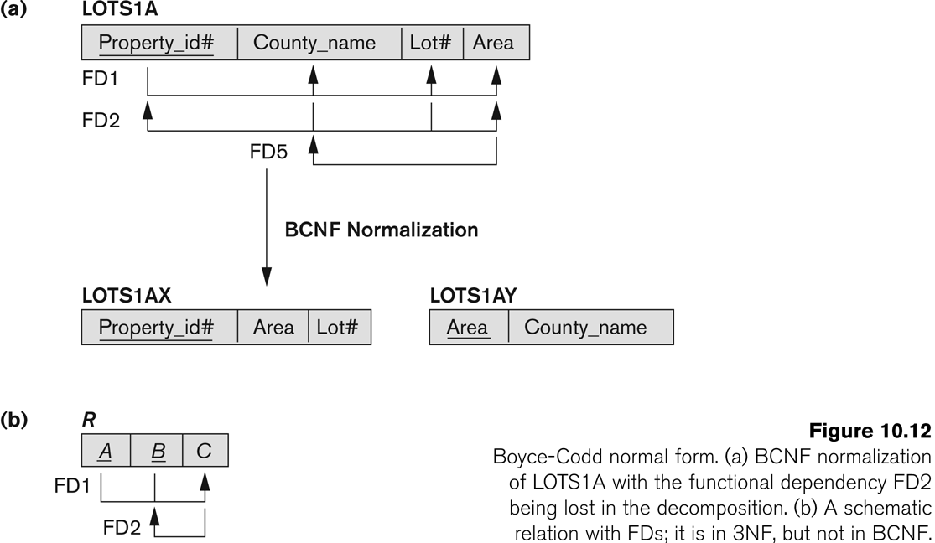
3NF, Not in BCNF…….

Slide 22
Boyce-Code Normal Form (BCNF)
A relation is in BCNF if every determinant is a candidate key.

Slide 23
Boyce-Code Normal Form (BCNF)
A relation is in BCNF if every determinant is a candidate key.
Relation: Student(Sid,Subject,Trainer,Percentage)
Sid | Subject | Trainer | Percentage
123 | Data Structure | Prof. Rahul | 68
123 | DBMS | Prof. JP | 79
456 | OOPM | Prof. Sachin | 89
789 | TOC | Prof. Ganesh | 81
678 | Data structure | Prof. Rahul | 76

Slide 24
BCNF
FD1: Sid,Subject→ Trainer
FD2: Sid,Subject→ Percentage
FD3: Trainer → Subject
1.The determinants are:
Sid,Subject
Trainer

Slide 25
BCNF
Create a new relation from the functional dependency:
Student(Sid , Trainer,Percentage)
Advisor(Trainer,Subject)

Slide 26
In 3NF, but not in BCNF:
Instructor teaches one course only.
student_no
instr_no
course_no
Student takes a course and has one instructor. Student can take more than one course.
{student_no, instr_no} → course_no
course_no ->instr_no
since we have course_no ->instr_no
, but Course_no is not a Candidate key.

Slide 27
BCNF: Eg
student_no
course_no
instr_no
BCNF
student_no
course_no
course_no
instr_no

Slide 28
Key points
BCNF is free from redundancy.
If a relation is in BCNF, then 3NF is also also satisfied.
If all attributes of relation are prime attribute, then the relation is always in 3NF.
A relation in a Relational Database is always and at least in 1NF form.

Slide 29
Every Binary Relation ( a Relation with only 2 attributes ) is always in BCNF.
If a Relation has only singleton candidate keys( i.e. every candidate key consists of only 1 attribute), then the Relation is always in 2NF( because no Partial functional dependency possible).

Slide 30
Sometimes going for BCNF form may not preserve functional dependency. In that case go for BCNF only if the lost FD(s) is not required, else normalize till 3NF only.
There are many more Normal forms that exist after BCNF, like 4NF and more. But in real world database systems it’s generally not required to go beyond BCNF.

Slide 31
Multivalued dependency
Let R be a relation schema and let X and Y be subsets of the attributes of R.The multivalued dependency X ‐>‐>Y is said to hold over R if,in every legal instance r of R, each X value is associated with a set of Y values and this set is independent of the values in the other attributes.
OR
For a dependency A → B, if for a single value of A, multiple values of B exists, then the relation will be a multi-valued dependency.

Slide 32
Course ->-> Book Course ->-> Teacher
Multivalued Dependencies
Course | Teacher | Book
Physics101 | Green | Electronics
Physics101 | Green | Optics
Physics101 | Brown | Mechanics
Maths301 | Brown | Geometry
Maths301 | Green | Vectors
Maths301 | Green | Algebra

Slide 33
Multivalued Dependencies
Course | Book
Physics101 | Electronics
Physics101 | Optics
Maths301 | Geometry
Maths301 | Vectors
Maths301 | Alegbra
Course | Teacher
Physics101 | Green
Physics101 | Brown
Maths301 | Green

Slide 34
Fourth Normal Form (4NF)
4NF is a direct generalisation of BCNF.
A relation will be in 4NF if it is in Boyce Codd normal form and has no multi-valued dependency.
Let R be a relation schema, X and Y be non empty subsets of the attributes of R, and F' be a set of dependencies that includes both FDs and MVDs.
R is said to be in fourth normal form (4NF), if, for every MVD X->->Y that holds over R, one of the following statements is true:
• Y E X or XY=R or
• X is a superkey.

